Slide 1
Improved dynamic reachability algorithms for directed graphs
Liam Roditty and Uri Zwick
Tel Aviv University

Slide 2
Dynamic reachability
The dynamic graph
Transitive closure matrix
3
3
3
3
 | 1 | 2 | 3 | 4 | 5 | 6 | 7 | 8
1 | 1 | 1 | 1 | 1 | 1 | 1 | 1 | 1
2 | 1 | 1 | 1 | 1 | 1 | 1 | 1 | 1
3 | 1 | 1 | 1 | 1 | 1 | 1 | 1 | 1
4 | 1 | 1 | 1 | 1 | 1 | 1 | 1 | 1
5 |  |  |  |  | 1 | 1 | 1 | 1
6 |  |  |  |  | 1 | 1 | 1 | 1
7 |  |  |  |  | 1 | 1 | 1 | 1
8 |  |  |  |  | 1 | 1 | 1 | 1
2
4
2
2
2
4
4
4
1
1
1
1
1 | 1 | 1 | 1
1 | 1 | 1 | 1
1 | 1 | 1 | 1
1 | 1 | 1 | 1
5
5
5
5
8
6
8
8
6
8
6
6
Operations
7
7
7
7
Delete (1,5) (4,1)
Reach? (1,4)
Insert (5,1) (5,2) (5,4)
Delete (2,3) (6,7) (8,5)

Slide 3
Decremental reachability - Results
Graphs | Algorithm | Query time | Total update time | Authors
DAGs | Deterministic | 1 | mn | Italiano ’88
General | Monte Carlo | n log n | mn log² n | Henzinger King ’95
General | Deterministic | 1 | m² | La Poutré van Leeuwen ’87 FMNZ ’01
General | Deterministic | 1 | n³ | Demetrescu Italiano ’00
General | Monte Carlo | 1 | mn^{4/3} | Baswana Hariharan Sen ’02
General | Las Vegas | 1 | mn | RZ ’02

Slide 4
Fully dynamic reachability - Results
Graphs | Algorithm | Query time | Amortized update time | Authors
General | Deterministic | 1 | n² log n | King ’99
General | Deterministic | 1 | n² | Demetrescu Italiano ’00
General | Deterministic | 1 | n² | Roditty ’03

Slide 5
Fully dynamic reachability - Results
Graphs | Algorithm | Query time | Amortized update time | Authors
DAGs | Monte Carlo | n^{0.58} | n^{1.58} | Demetrescu, Italiano ’00
DAGs | Deterministic | n log n | m | RZ ’02
General | Monte Carlo | n log n | mn^{1/2} log² n | Henzinger King ’95
General | Monte Carlo | n log n | m^{0.58}n
General | Deterministic | n^{1/2} | mn^{1/2} | RZ ’02
General | Monte Carlo | m^{0.43} | m^{0.58}n

Slide 6
Decremental maintenance of a reachability tree in a DAG – Italiano’s algorithm
Every edge is only examined once!
Total complexity
is O(m) per tree.

Slide 7
Decremental maintenance of a reachability tree in a general graph
Frigioni, Miller, Nanni and Zaroliagis ’01
If a deleted edge is in a SCC, and the SCC remains strongly connected, do nothing.
The graph induced on the Strongly Connected Components (SCCs)
of a graph is a DAG.
If a deleted edge connects two different SCCs,
use Italiano’s algorithm.
Maintain a reachability tree of SCCs !

Slide 8
When a SCC decomposes

Slide 9
How do we maintain the SCCs?
FMNZ’01 recompute the SCCs for each deleted edge. Thus, the worst-case complexity of their algorithm is O(m²).
We maintain the SCC components
in O(mn) expected time.
This reduces the total
expected time to O(mn).

Slide 10
Decremental maintenance of a BFS tree in a general graph
Even, Shiloach ’81 / Henzinger, King ’95
Every edge is only examined once
per level!
Total complexity
is O(mn).

Slide 11
Detecting the decomposition of a SCC
Choose a representative vertex w in the SCC.
Construct and maintain a BFS tree out of w, and a BFS tree into w.
The SCC decomposes only when one of these trees looses a vertex.
w

Slide 12
When a SCC decomposes
w
Total cost:
mn +
m₁n₁+m₂n₂+m₃n₃+m₄n₄+
…
w₁
w₂
w
w₃
w₄
= O(mn) ???

Slide 13
Choice of representatives
Choose a
RANDOM representative !!!
w
w
w
Expected running time is then O(mn) !!!

Slide 14

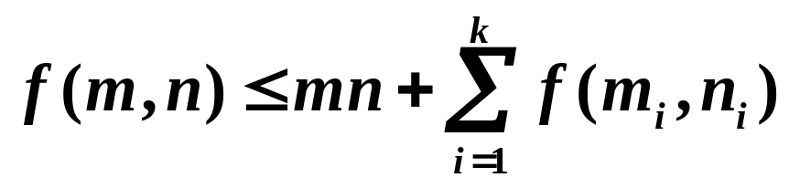
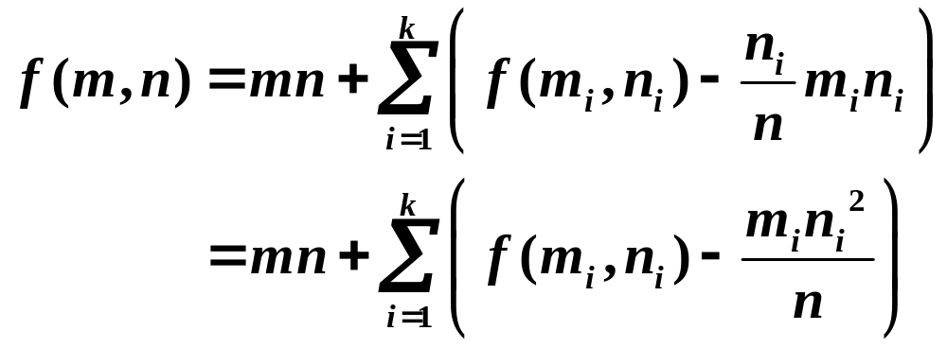
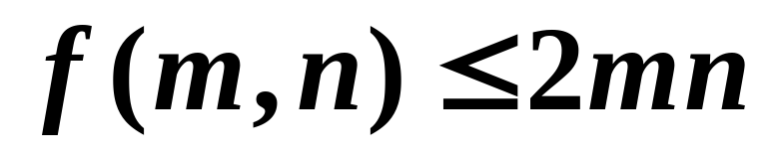
Decremental SCCs - Analysis
Let be the expected total running time.

Slide 15
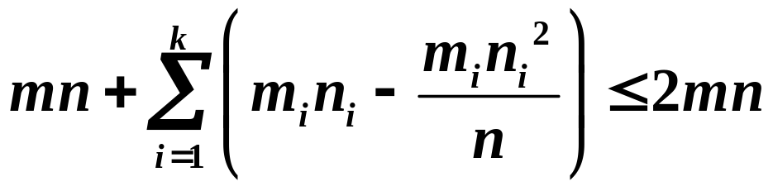
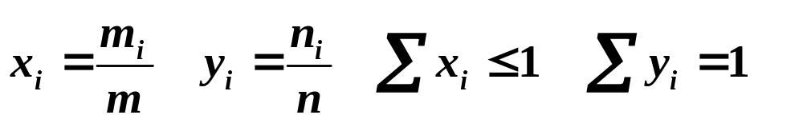
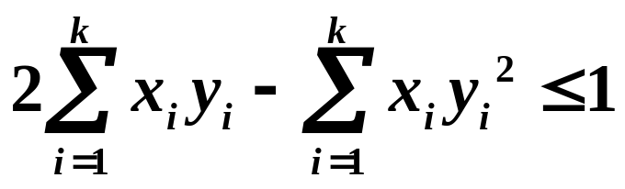
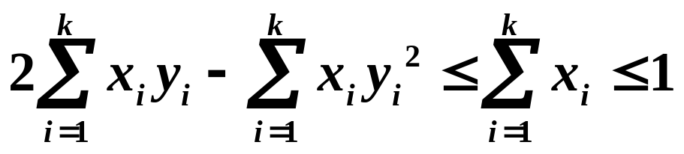
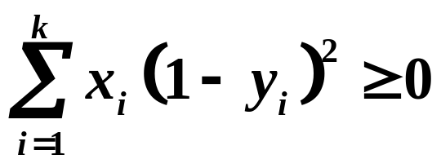
Decremental SCCs - Analysis

Slide 16
Fully dynamic reachability
(after Henzinger-King ’95)
Delete(E’) – Update the decremental data structure and rebuild all trees.
O(mt) time.
Reach?(u,v) – Query the decremental data structure and each pair of trees.
O(t) time
Initialize a decremental data structure
O(mn) time
Insert(E_{v}) – build/rebuild In(v) and Out(v). O(m) time.
When t=n^{1/2}, restart.
Amortized cost per update – O(mn^{1/2})
Worst-case query time – O(n^{1/2})
…
v₁
v₂
v_{t}
Decremental data structure
G

Slide 17
Decremental reachability –
Open problems
Is there a decremental algorithm for maintaining the strongly connected components of a directed graph whose total running time is o(mn)?
Is there a deterministic decremental algorithm for maintaining the transitive closure of a general directed graph whose total running time is O(mn)?
Is there a decremental algorithm for maintaining a
shortest-paths tree, or even just a reachability tree, from a single source in a general directed graph whose total running time is o(mn)?

Slide 18
Fully dynamic reachability –
Open problems
Is there a fully dynamic reachability algorithm with an amortized update time of o(n²) , and worst case query time of o(m) for general directed graphs?
        Interesting lower bounds?

